Slide 1
Onshore winds as a driver of increased recruitment
Schilling
Suthers
Gillson
Hinchliffe

Slide 2
Hypothesis
Onshore winds drive increased fisheries recruitment
Hypothesised by Dannevig!
Either by upwelling (NE Winds) or Retention (SE Winds)
Or E winds

Slide 3
Aims
Test Dannevig hypothesis by testing:
During onshore winds are larvae retained against the coast?
Use NIMO Database to test for relationship between winds, larval abundance and distance from coastline
This would demonstrate the mechanism
Can we see this in commercial CPUE
Using Gillson et al 2009 meshnet data with lagged winds (controlling for many factors)
At an estuary scale?
At a larger scale?
This would show important commercial implications

Slide 4
Methods
NIMO Larval Fish Database (Smith et al 2016)
NSW DPI Estuary Meshnet Data (Gillson et al 2009) – 4 species, 8 estuaries
NOAA Global modelled winds =
NOAA-CIRES Twentieth Century Reanalysis (V2c)
3 hourly measurements, surface level (~200km² resolution)
Using estuary specific winds for estuary specific
Using Sydney winds for larger scale
Only up to 2015 (so limits larval fish marginally, up to 2018 will be available in late September)

Slide 5
Aim 1: Larval Fish
General Linear Mixed Model with Negative Binomial Distribution
Response = Total Larval Abundance
Random Effect = Project Code (proxy for time, method of collection)
Fixed Effects = Distance from coast*SE Winds*NE Winds
Winds are Sydney winds (2 weeks leading up to capture)
We are interested in the interactions
If hypothesis is correct, we should see increased larval near the coast during strong winds.
If it’s strong SE winds then retention is responsible
If it’s strong NE winds then upwelling is responsible
If it’s both then it’s just wind? Or something else?

Slide 6
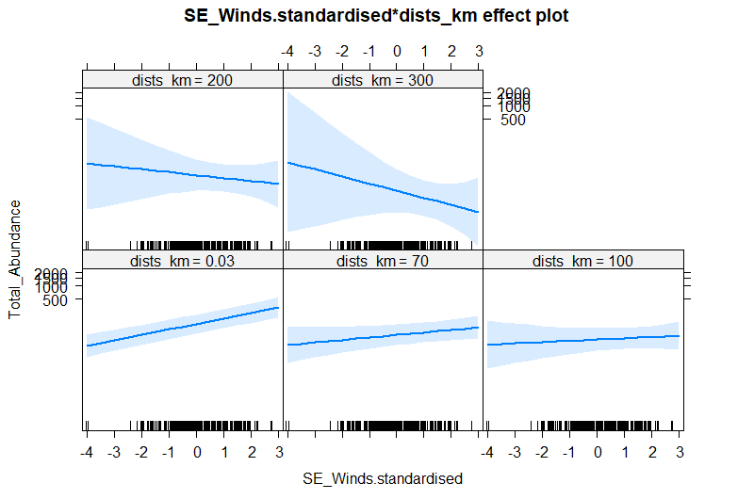
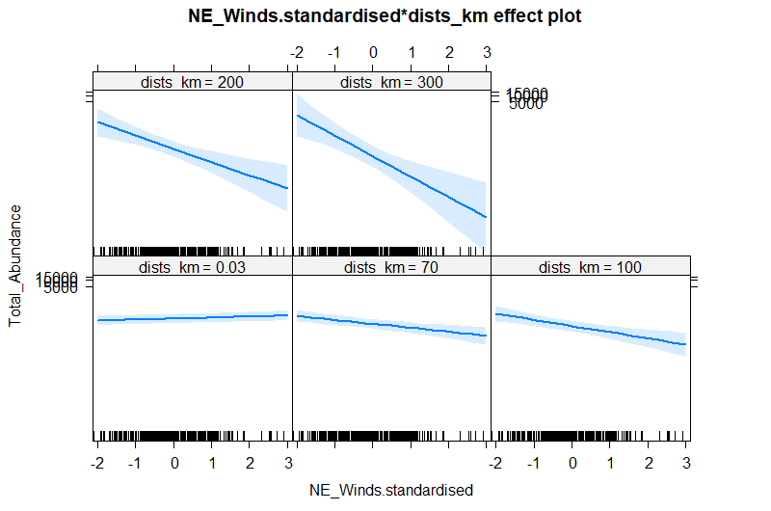
Larval Fish Results – Total Abundance
Plot slopes with distance
Latitudes 30 – 36
Sydney port hacking
In strong winds, larval fish increase in abundance near the coast – bigger effect for SE but NE also significant
Error bars may be wrong (plotting a GLMM gives a warning – work in progress)

Slide 7
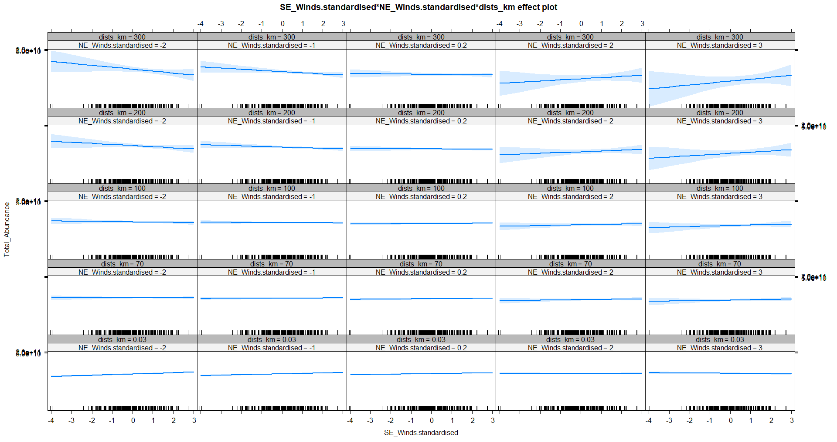
Larval Fish Results – Total Normalised Abund.
Tweedie Distribution

Slide 8
Aim 2: Commercial CPUE – Local Scale
Use results on the mechanism in Aim 1 to drive model design in Aim 2 (which winds to use, SE, NE or both)
Many linear models (model for each estuary/species CPUE combination)
Adjust p-values for multiple testing
Use lagged winds based on FRDC Age compositions from mesh nets in Clarence River
Control for drought (as continuous – number of drought declared months)

Slide 9
Commercial – Local Scale Results
No real evidence of relationships
I think conclusion is too much variability in this data to see this pattern at this scale (10 datapoints per plot – not enough)
Most no relationship or slight positive trend
Need to quantify better
See other powerpoint full of plots

Slide 10
Aim 2: Commercial CPUE – Large Scale
Use results on the mechanism in Aim 1 to drive model design in Aim 2 (which winds to use, SE, NE or both)
Linear models (model for each species)
Adjust p-values for multiple testing
Use lagged winds based on FRDC Age compositions from mesh nets in Clarence River
Control for drought (as continuous – number of drought declared months)
CPUE Normalised within each estuary (-1 to 1)
Winds Scaled (mean of 0, sd of 1)
Random effect of estuary or estuary type?

Slide 11
Commercial data – Large Scale
Drought generally has a positive effect
Bream show the wind trend with lagged SE winds strongly
Luderick have weak evidence of effect (P = 0.09)
Whiting strong positive drought effect only
Mullet no effects
Flathead show no effects
Total CPUE no effects
Add estuary and remove normalisation
Remove big rivers (avoid drought effect)
Remove current winds
Try without current wind

Slide 12
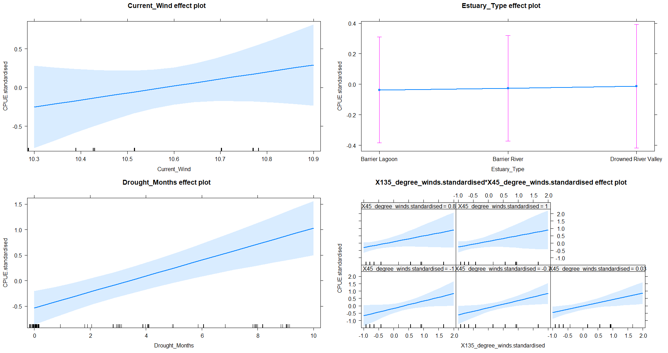
Bream
Try drought*estuary type

Slide 13
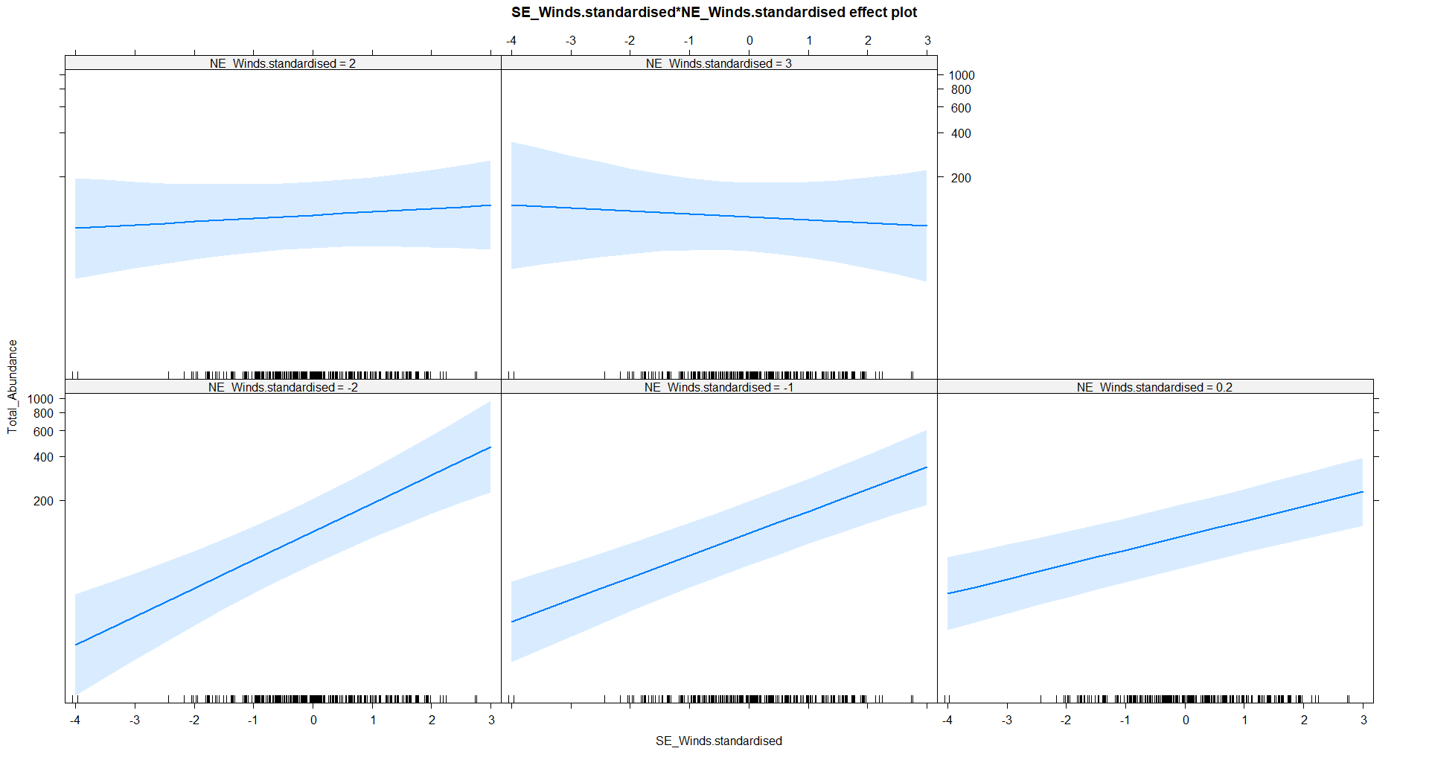
Luderick

